Slide 1
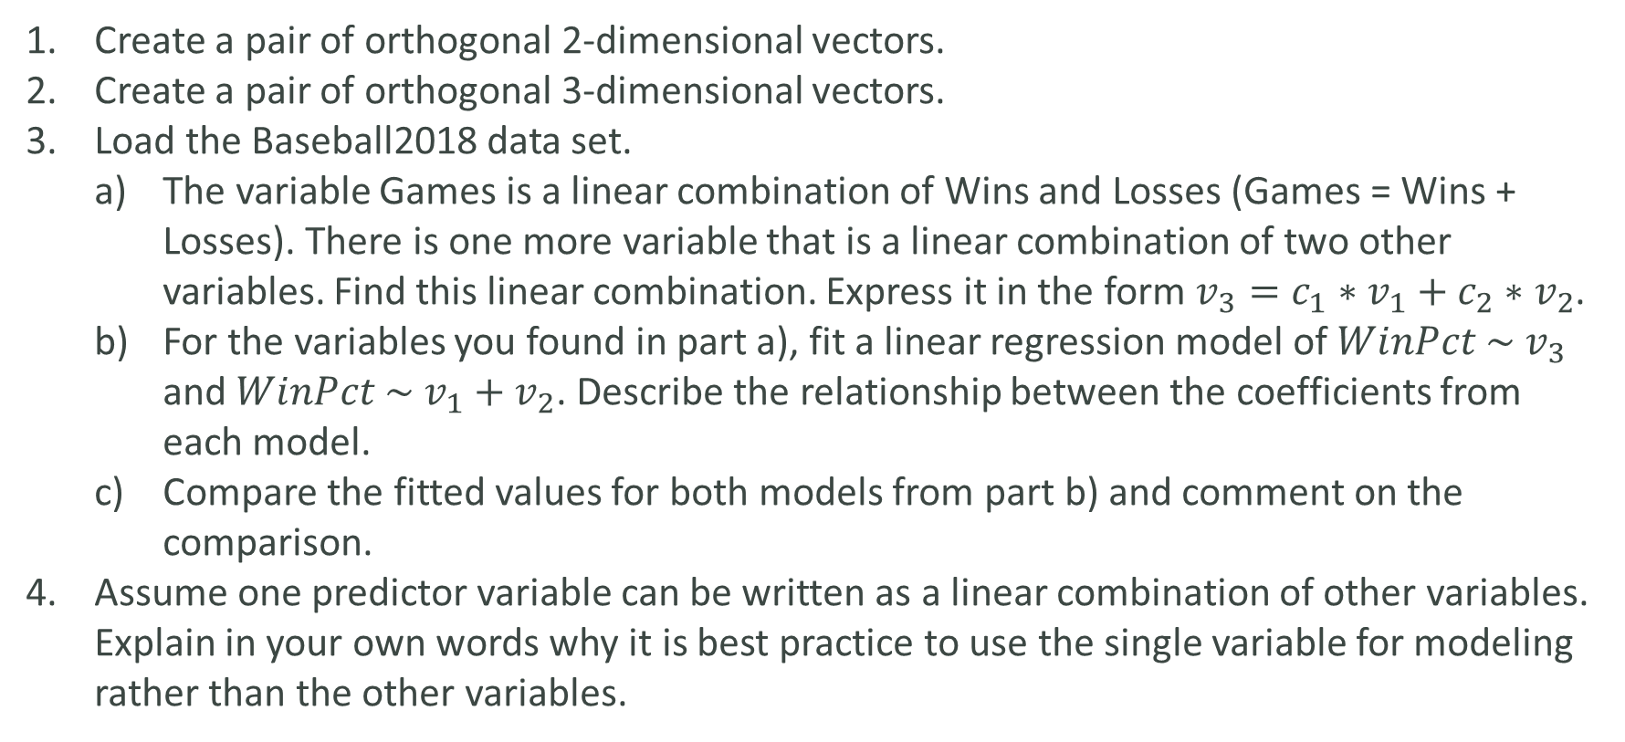
LAB
Create a pair of orthogonal 2-dimensional vectors.
Create a pair of orthogonal 3-dimensional vectors.
Load the Baseball2018 data set.
The variable Games is a linear combination of Wins and Losses (Games = Wins + Losses). There is one more variable that is a linear combination of two other variables. Find this linear combination. Express it in the form $v_{3}=c_{1}∗v_{1}+c_{2}∗v_{2}$.
For the variables you found in part a), fit a linear regression model of $WinPct \sim v_{3}$ and $WinPct \sim v_{1}+v_{2}$. Describe the relationship between the coefficients from each model.
Compare the fitted values for both models from part b) and comment on the comparison.
Assume one predictor variable can be written as a linear combination of other variables. Explain in your own words why it is best practice to use the single variable for modeling rather than the other variables.

